Slide 1
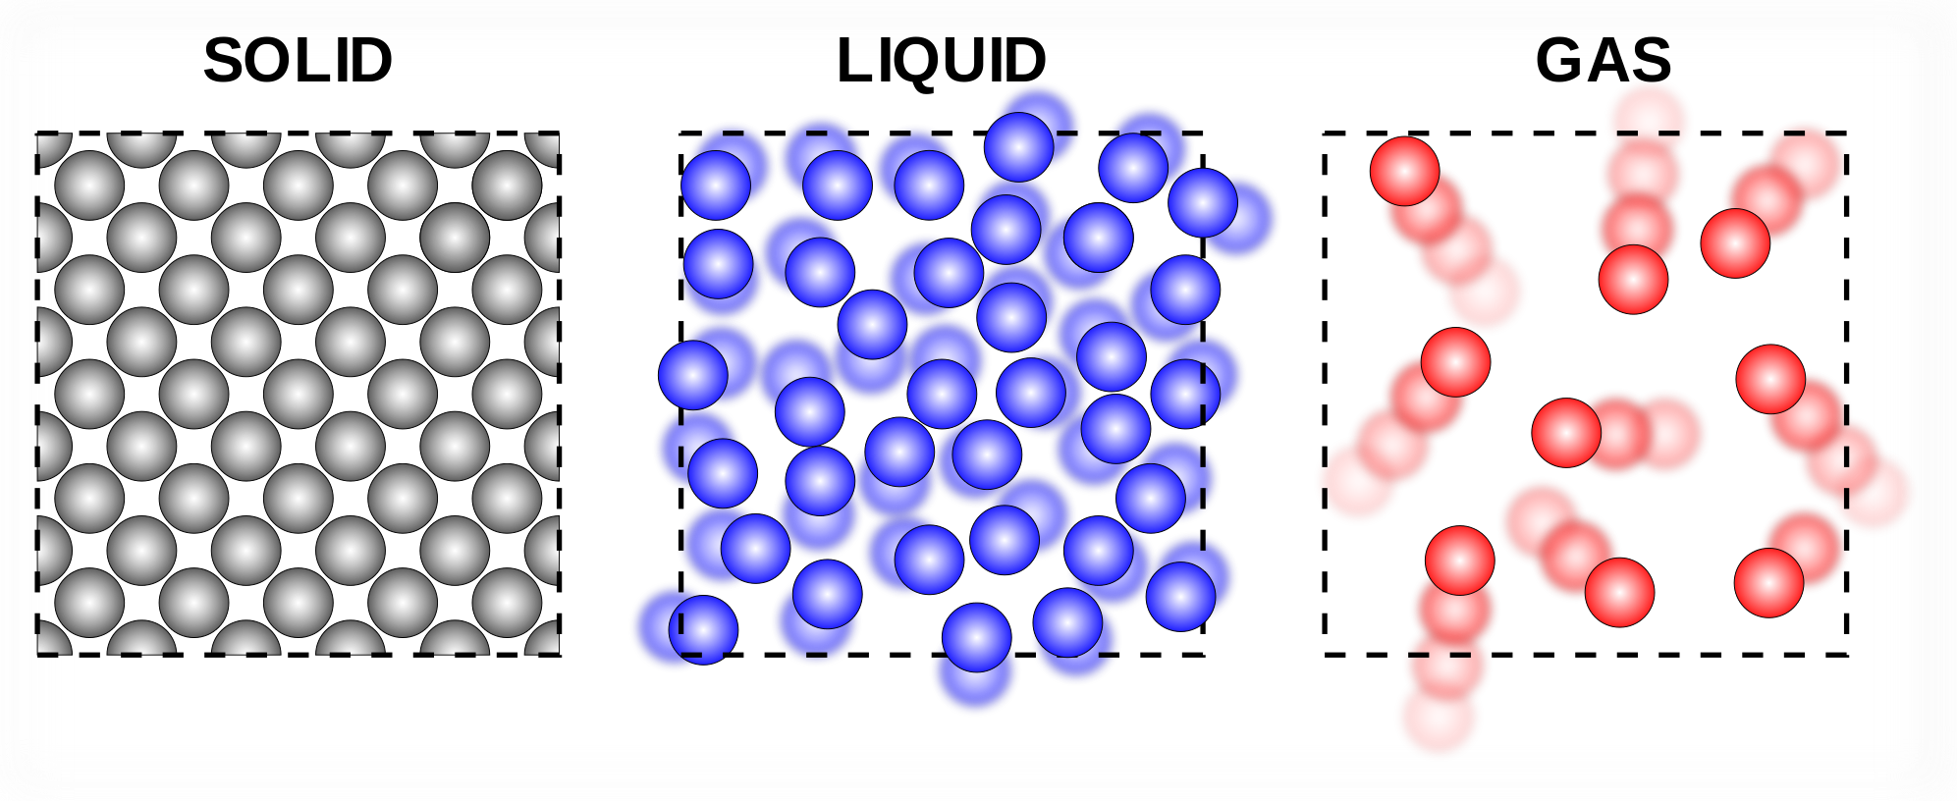
Identify which of these is a solid, which is a liquid, and which is a gas

Slide 2

Mixtures and Solutions
We will learn about different types of mixtures and solutions
Notes:
Insert cover image and use transparency settings to fade image.

Slide 3
Do not delete this slide.
This slide is designed so that you can copy the prompt box you need and insert it into your slides.
This slide is hidden and will not be included when presenting your lesson.
VOCABULARY
1 -
HINT
Students, remember….
CHECK FOR UNDERSTANDING
TEACHER CUE
MAKE THE CONNECTION
Students, you already know….
EXTENSION
TRACK WITH ME
READ WITH ME

Slide 4
Repeat the opposite word/phrase.
INDEPENDENT VARIABLE
WHAT WE CHANGE

Slide 5
Repeat the opposite word/phrase.
DEPENDENT VARIABLE
WHAT WE MEASURE

Slide 6
Repeat the opposite word/phrase.
CONTROL VARIABLE
WHAT STAYS THE SAME

Slide 7
We will learn about the different types of mixtures
TRACK WITH ME
READ WITH ME
We will list pure substances and mixtures
We will define the terms homogenous, heterogenous, and suspension
We will define the terms solution, solute, concentration, saturation, and dilution
DECLARE THE OBJECTIVE
Read the learning objective to your partner.
Notes:
Learning Objectives contain concepts (nouns, big ideas), skills (verbs, measurable behaviours) and sometimes context (restricting or targeting conditions).
●Example: Students will be able to describe the concept of density and apply it to floating and sinking.
●
Success criteria are specific measurable outcomes that if met mean that the student has met the learning objective.
Examples:
•Students will be able to compare densities of substances using mass and volume.
•Students will be able to identify whether a solid or liquid will float or sink in a liquid based on their densities.

Slide 8
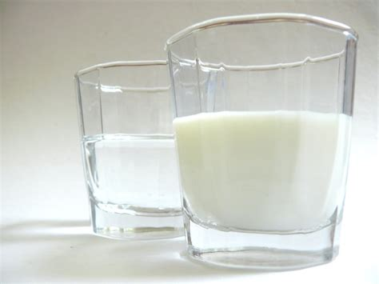
We will list pure substances and mixtures
End
1
2
3
4
5
6
7
8
9
10
11
12
13
14
15
16
17
18
19
20
21
22
23
24
25
26
27
28
29
30
31
32
33
34
35
36
37
38
39
40
41
42
43
44
45
46
47
48
49
50
51
52
53
54
55
56
57
58
59
60
Think-Pair-Share: What is the difference between milk and water?
HINT
What happens when you look through each of these?

Slide 9
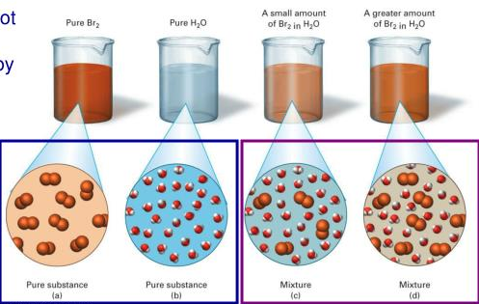
We will list pure substances and mixtures
TRACK WITH ME
Pure substances: substances made up of only one chemical. Eg, water, sugar, salt
Mixtures: anything that’s made up of multiple chemicals. Eg, milk, rocks, people
EXTENSION
If we add something to water and mix it so that the compound disappears, it is called a solution
CHECK FOR UNDERSTANDING
How many different mixtures and pure substances can you think of?

Slide 10
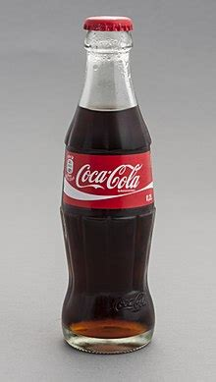

We will list pure substances and mixtures
3 minutes
Classify each of the following as pure or a mixture
Water
Coca-cola
Copper
Oxygen
Paint
Air
HINT
Pure substances contain only one chemical, mixtures are made of multiple chemicals

Slide 11
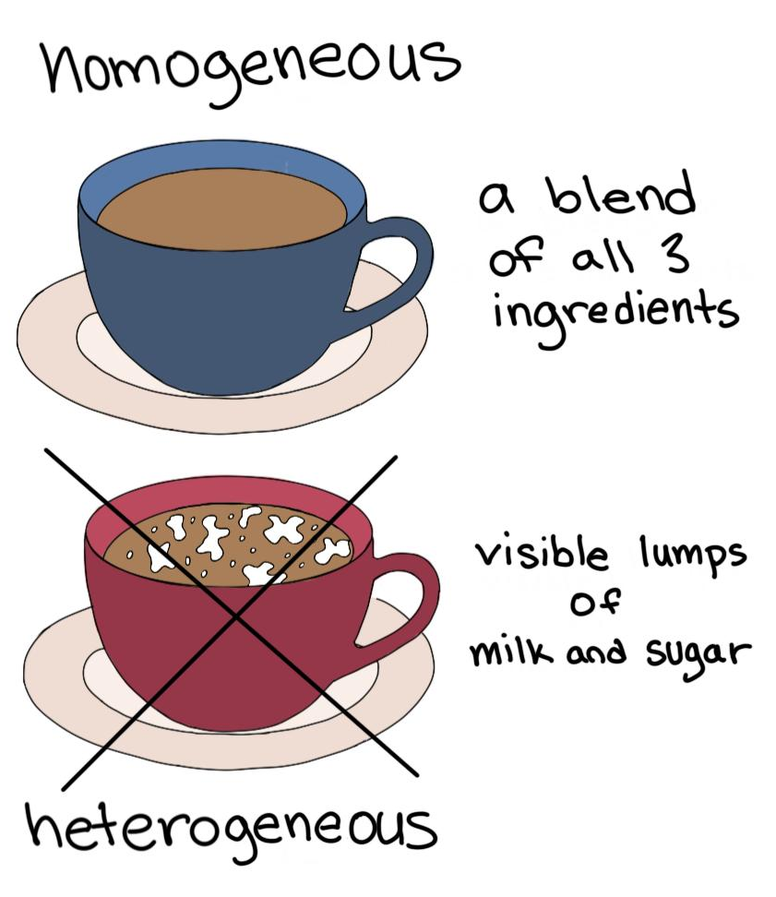
We will define terms describing mixtures
TRACK WITH ME
We have a few words we use to describe mixtures:
Homogenous (everything in the mixture are the same state; looks the same)
Heterogenous (things in the mixture are in different states; looks different)
Heterogenous mixtures can be separated physically; homogenous mixtures cannot be separated physically, and require chemicals
MAKE THE CONNECTION
The bottom cup is heterogenous because we could pick out the sugar if we wanted to

Slide 12
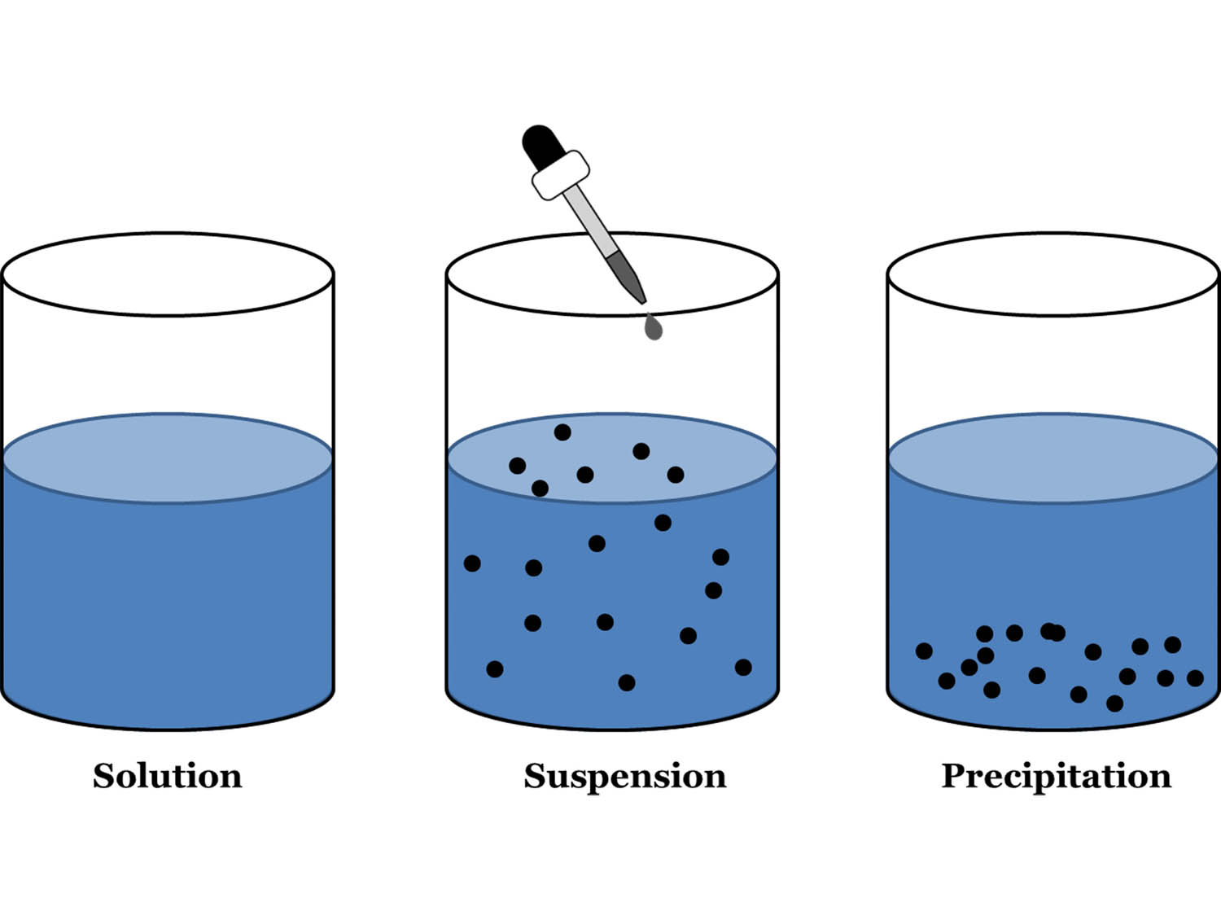
We will define terms describing mixtures
TRACK WITH ME
One type of mixture we’ve discussed before is a suspension₁
A suspension is a liquid with solid particles floating through it – these solid particles are called a sediment₂
VOCABULARY
1 – liquid with solid particles through it 2 –a solid particle in liquid, usually they float to the bottom
EXTENSION
A liquid with a microscopic amount of something dissolved in it is called a colloid

Slide 13
5 minutes
We will define terms describing mixtures
Draw an example of:
A homogenous mixture
A heterogenous mixture
A suspension
List an example of:
A homogenous mixture
A heterogenous mixture
A suspension
CHECK FOR UNDERSTANDING
Does what you drew look like what a friend drew?

Slide 14
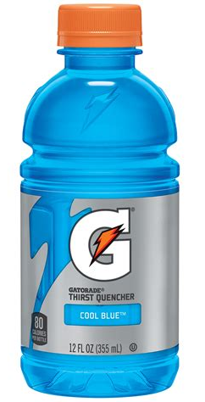
We will define terms describing mixtures
TRACK WITH ME
Solutions are homogenous mixtures in which one or more chemicals (solute) is dissolved in a liquid (solvent)
For example, Gatorade is a solution where the solutes are sugar, electrolytes (salt), and some flavouring, dissolved in the solvent water
The amount of solute dissolved in a volume of solvent is called the concentration
EXTENSION
What other solvents can you think of that exist?

Slide 15
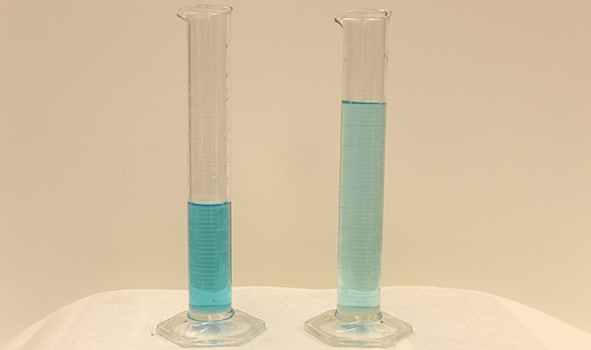
We will define terms describing mixtures
End
1
2
3
4
5
6
7
8
9
10
11
12
13
14
15
16
17
18
19
20
21
22
23
24
25
26
27
28
29
30
31
32
33
34
35
36
37
38
39
40
41
42
43
44
45
46
47
48
49
50
51
52
53
54
55
56
57
58
59
60
Think-Pair-Share: if I add pure water to a bottle of Gatorade that is half-full, what do you think will happen?
HINT
What will it look like? What will it smell like? What will it taste like?

Slide 16
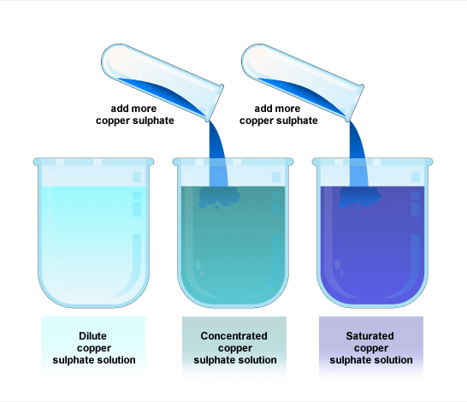
We will define terms describing mixtures
VOCABULARY
1 – the liquid used in a solution 2 – the amount of solute dissolved in an amount of solvent 3 – the stuff dissolved in the solution
If you add more pure solvent₁, the concentration₂ will decrease. This is called a dilution. If you add more solute₃, the concentration₂ will increase
If you keep adding solute, eventually
you will reach a point where you can’t
add anymore. This is called saturation

Slide 17
8 minutes
We will define terms describing mixtures
For each of the following, identify the solute and the solution:
Copper sulphate in water
Weed killer in water
Beer
Blood
Vinegar
Seawater
Soft Drinks
Air

Slide 18
We will learn about the different types of mixtures
TRACK WITH ME
READ WITH ME
We will list pure substances and mixtures
We will define the terms homogenous, heterogenous, and suspension
We will define the terms solution, solute, concentration, saturation, and dilution
DECLARE THE OBJECTIVE
Read the learning objective to your partner.
Notes:
Learning Objectives contain concepts (nouns, big ideas), skills (verbs, measurable behaviours) and sometimes context (restricting or targeting conditions).
●Example: Students will be able to describe the concept of density and apply it to floating and sinking.
●
Success criteria are specific measurable outcomes that if met mean that the student has met the learning objective.
Examples:
•Students will be able to compare densities of substances using mass and volume.
•Students will be able to identify whether a solid or liquid will float or sink in a liquid based on their densities.

